Slide 1


Slide 2
Disassembler Project: Approach

Slide 3
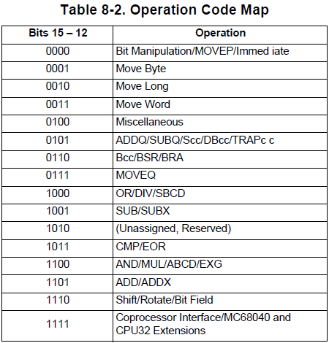

Slide 4
(RTFM)

Slide 5
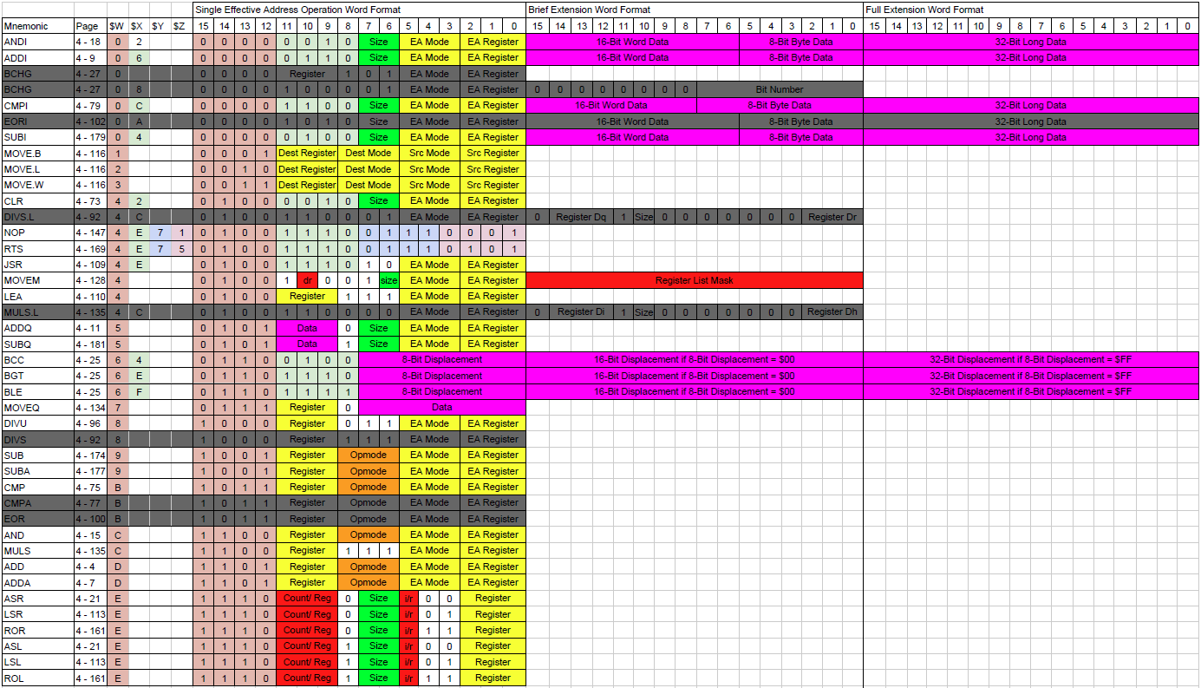

Slide 7
I really, REALLY want to find NOP.

Slide 8
Assembling the NOP instruction gives me 4E71.

Slide 9
NOP: 4E71

Slide 10
NOP: 4E71

Slide 11
NOP: 4E71

Slide 12
NOP: 4E71

Slide 13
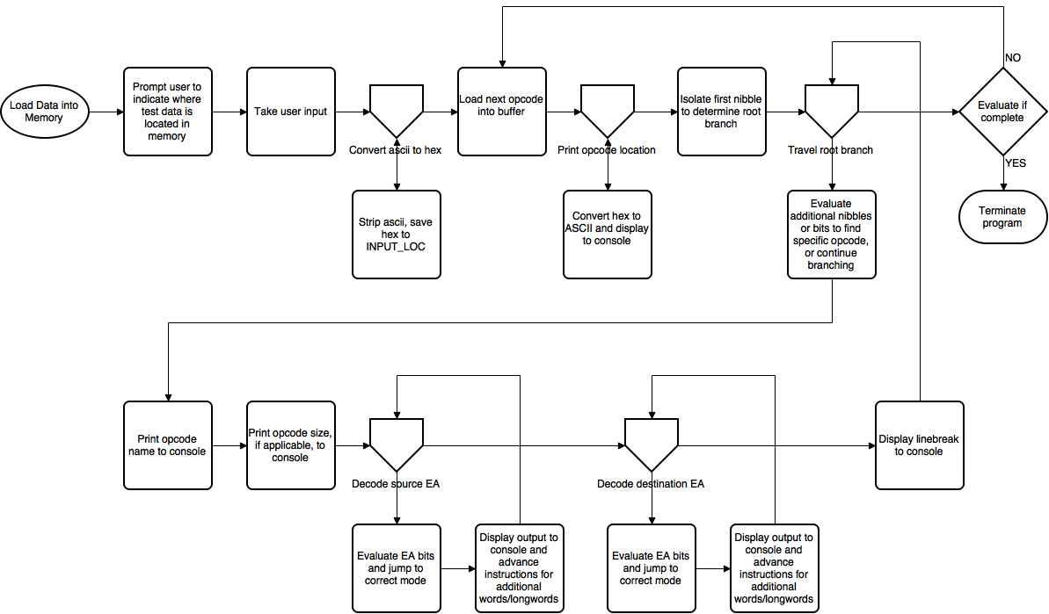

Slide 14
Disassembler Project: Implementation

Slide 15
EasyRiders_W16: The main assembly file controlling load location and includes.
EasyRiders_Parser: Contains all client interactivity
EasyRiders_Branch: Contains all code relating to input branching to find opcodes
EasyRiders_Opcodes: Contains all opcode decoding instructions
EasyRiders_Subroutines: Contains all methods that are jumped to and then returned from
EasyRiders_EAs: Contains all EA decoding instructions
EasyRiders_Definitions: Contains all constants, variables, and definitions

Slide 17
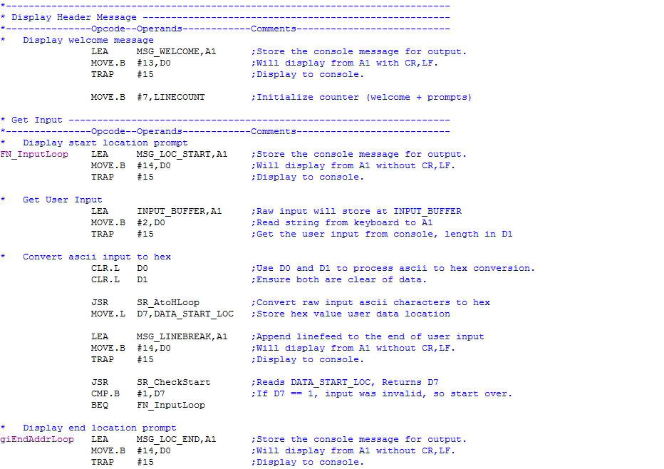

Slide 19
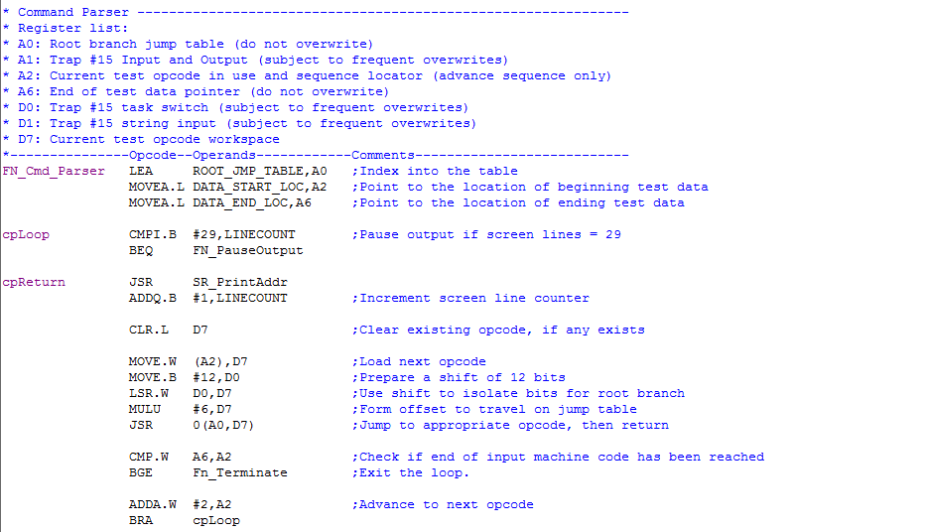

Slide 21
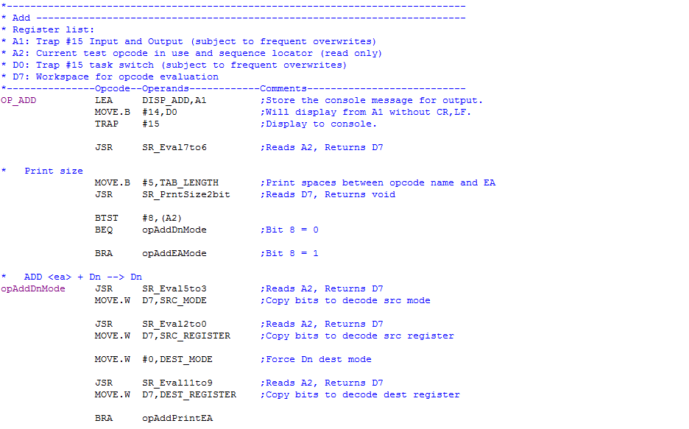

Slide 22
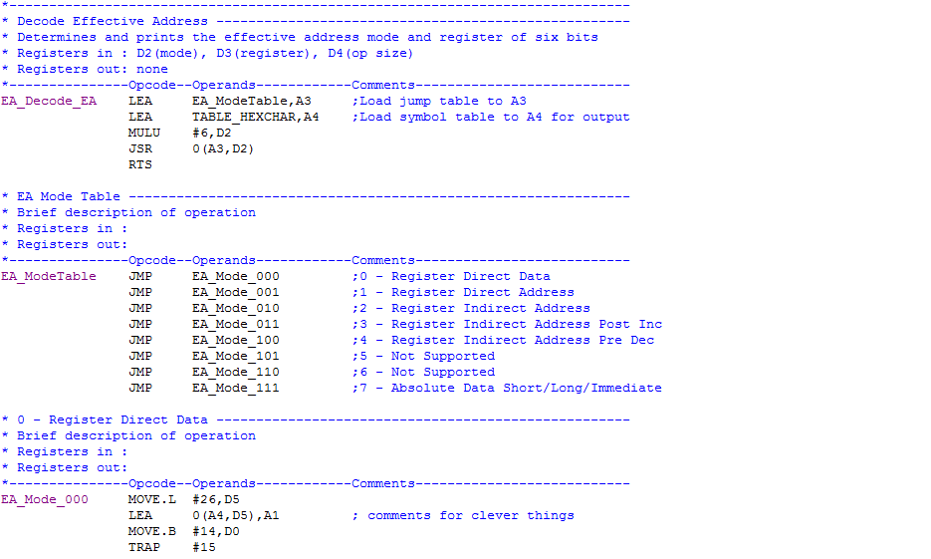

Slide 23
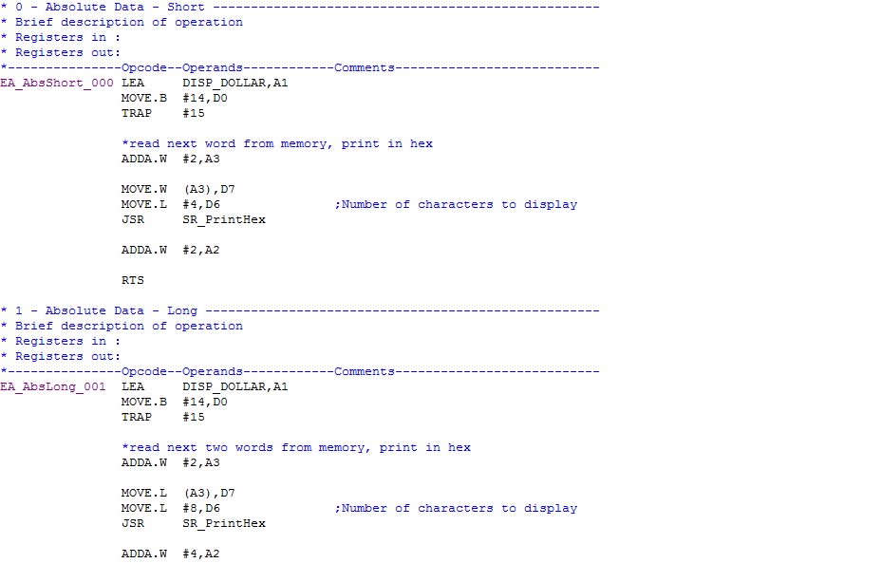

Slide 25
Disassembler Project: Status

Slide 26
All I/O and Effective Addressing modes are complete.
Accepts a beginning and ending address
Validates beginning addresses are not less than $0400 and not on an odd byte
Validates ending address are not located before beginning addresses
I/O branching evaluates all possible 68K opcodes. Unsupported opcodes display as ADDR DATA $WXYZ
Absolute Short/Long and Immediate addressing EAs properly sequence and display to the console.

Slide 27
Most opcodes are complete.
Complete: ADD, ADDA, ADDI, ADDQ, AND, ANDI, ASL, ASR, BCC, BGT, BLE, CLR, CMP, CMPI, DIVS, DIVU, JSR, LEA, LSL, LSR, MOVE, MOVEA, MOVEQ, MULS, MULU, NOP, ROL, ROR, RTS, SUB, SUBA, SUBI, SUBQ
Incomplete: MOVEM
A few of these were optionally added, but not all.
Must complete: MOVEM
Many opcodes share common logic and in some cases it’s easier to implement them.

Slide 28
Disassembler Project: Advice

Slide 29
* Assigned opcodes here
ADD.B D0,D1 ; D200 - ADD
ADDA.W D0,A0 ; D0C0 - ADDA
ADDI.B #$FF,D0 ; 0600 00FF - ADDI
ADDI.B #1,D0 ; 5200 - ADDQ
AND.B D0,D1 ; C200 - AND
ANDI.B #1,D0 ; 0200 0001 - ANDI
ASR.B #1,D0 ; E200 - SHIFT_ROT
BCC.B test1 ; 6450 - BCC
BCC test1 ; 6400 004E - BCC
One BGT.B test2 ; 6E4C - BCC
BGT test2 ; 6E00 004A - BCC
Two BLE.B test3 ; 6F48 - BCC
BLE test3 ; 6F00 0046 - BCC
Three CLR.B D0 ; 4200 - CLR
CMP.B D0,D1 ; B200 - CMP
CMPI.B #1,D0 ; 0C00 0001 - CMPI
NOT.W D1 ; 4641 - NOT (Invalid)
DIVU.W #1,D1 ; 82FC 0001 - DIVU
JSR test4 ; 4EB9 0000706A - JSR
LEA msg,A0 ; 41F9 0000706C - LEA
LSL.B #1,D0 ; E308 - SHIFT_ROT
MOVE.B D0,D1 ; 1200 - MOVEB
MOVE.L D0,D1 ; 2200 - MOVEL
MOVE.W D0,D1 ; 3200 - MOVEW
MOVEM.W D0,-(SP) ; 48A7 8000 - MOVEM_TO_EA
MOVEQ.L #1,D0 ; 7001 - MOVEQ
MULS.W D0,D1 ; C3C0 - MULS
NOP ; 4E71 - NOP
ROL.B #1,D0 ; E318 - SHIFT_ROT
SUB.B #1,D0 ; 5300 - SUBQ
SUB.B #$FF,D0 ; 0040 00FF - SUBI
SUB.B D0,D1 ; 9200 - SUB
Create a test program that will test all your opcode branches.
Don’t work inside of a single, huge file. Use #include.
Find a naming scheme that is readable and is traceable.
Define Storage (DS) for variables.
Use and be proficient with version control.

Slide 30
Disassembler Project: Demo

